Slide 1
Clash of Cultures and Marching North

Slide 2
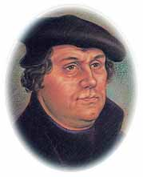
Chapter 21: Beliefs and Ideas
15th century~ Roman Catholic and Eastern Orthodox~only Christian religions
16th Century~Martin Luther
A reformer
Lists 95 complaints against the Catholic Church
(95 Theses)
Founds Protestantism

Slide 3
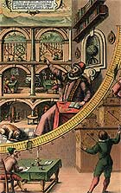
Age of Reformation
A time of change and reform
New religions forming (Protestantism)
Education
Travel and exploration

Slide 4
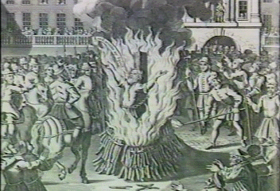
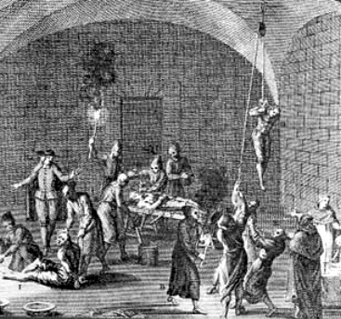
Convert, Leave, OR be Tortured and Die!!!!!
The Spanish Inquisition
Queen Isabella’s “special” religious court
Muslims, Jews, and Pagans would have to convert to Christianity
No conversion = leaving Spain or dying

Slide 5
New Spain
Hernando Cortez
Thought to be a god (Quetzacoatl) by Montezuma
Traveled with 900 people
Sank his own ships
Marched towards Tenochtitlan

Slide 6
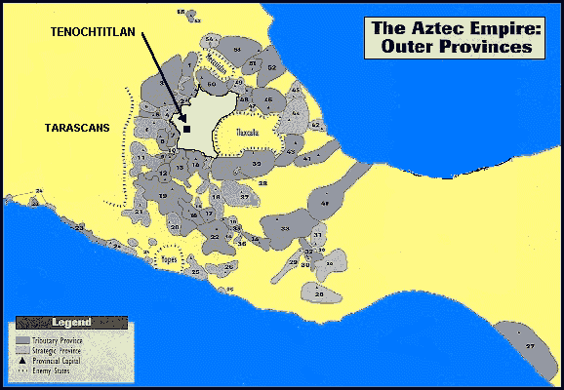
A map of the Aztec Empire

Slide 7
Cortez Marches Ahead
Doesn’t listen to Montezuma and marches towards Tenochtitlan
Builds army as he goes
In awe of city
Floating gardens
Private Zoo
GOLD!!!!!

Slide 8
The Aztecs fall
Montezuma dies
Cuauhtemoc (the new Aztec leader) surrenders to the Spanish
Spanish destroy the Aztec culture
Rename Tenochtitlan
Mexico City

Slide 9
Chapter 23: “Might Makes Right!”
Ponce de Leon
Mean & Bloodthirsty
Conquered Puerto Rico
Found Florida
Names for all its flowers
Found gold in Puerto Rico
Finally shot with a poison arrow
He dies from this

Slide 10
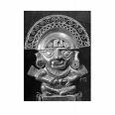
“Might Makes Right!”
Pizarro
Searched west coast of South America
Found treasures on in Peru
Defeated the Incas
Killed their leader (Atahualpa) after he demanded all their gold for his release
Melted all silver and gold into bars

Slide 11
Chapter 24: Gloom, Doom, & Cheer
Spanish gave the Indians:
Small Pox and Measles

Slide 12
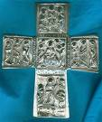
Chapter 24: Gloom, Doom, & Cheer
The Spanish also gave:
Religion
Language
Art
Education
1551-University
1539-Printing Press to Mexico City

Slide 13
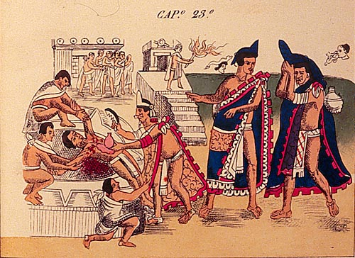
Chapter 24: Gloom, Doom, & Cheer
Spanish ended
Human Sacrifices

Slide 14
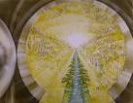
Chapter 25: North of New Spain
Explorers search for Cibola
7 cities of gold
Founded by 7 priests
Had to be in the north
Not in Africa or Europe

Slide 15
Esteban-sent by the mayor of Mexico City to find Cibola with Fray Marcos
1 of 4 survivors from Narvez
Captured by Indians (learned their culture)
Walked to Mexico in 8 years
Had to many female followers for Fray Marcos
Send crosses to show Cibola found
Killed when he sent Indians an symbol of war
Marcos went back to Mexico City and said they found Cibola

Slide 16
Chapter 26:Looking for Cibola with Coronado
Coronado: good leader/soldier
1540:leaves in search of Cibola
Gets to Hawikuh
Pueblo city
Kick Indians out and take over
Some go west and discover the Grand Canyon

Slide 17
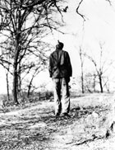
Chapter 26:Looking for Cibola with Coronado
“The Turk”
An Indian captured by the Spanish
Uses sign language to communicate
Spanish assume he’s telling them where the gold is
Takes them to Quivira-city full of mud huts
Strangled for lying
He wasn’t the gold and silver were underground!!!

Slide 18
Chapter 27: California to Florida
1540-1549:Spanish looking for Cibola all over! (California/Texas/Florida)
1539: De Soto- Florida (land of gold)
Collects 200lbs of pearls on his exploration
Was in Peru w/Pizarro
Took over Indian village
Kills/tortures if they don’t give in
Found survivor from Narvez
Finds the Mississippi River
Died of fever and was buried in the river

Slide 19
Chapter 27: California to Florida
1540-Alacron
1st to reach California
Sailed up the Gulf of California and Colorado River in the Grand Canyon
1524-Cabrillo (“lil goat”)
Believed California was run by Griffins
Died being chased by Indians

Slide 20
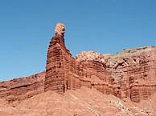
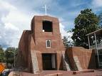
Chapter 28:A Place Called Santa Fe
Founded in 1610
Built on a plateau
First permanent European colony in North West America
1630-60,000 Indians converted to Christianity

Slide 21
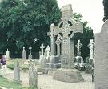
Chapter 29: Las Casas Cares
1542-King Charles 1 outlaws Indian slavery
Las Casas
had an Indian slave as a child
1512-became a priest & owned slaves
1514-gave his slaves their freedom
Dec 1520- established Venezuela (peaceful area)
Native Americans and Spanish
Didn’t want to work together

Slide 22
Chapter 29: Las Casas Cares
Sepulveda
Opposed Las Casas opinion
Native Americans “needed” Spanish
Slaves were good
English read about Spanish
Will treat Native Americans different!

Slide 23
THE END!!!!!

